Slide 1


Testing Spring MVC and REST Web Application

Slide 2
Agenda
• Spring TestContext Framework Updates
• Spring MVC Test Framework
• Q & A
5

Slide 3
What’s New in the Spring TCF?
• Upgraded to JUnit 5.11 and TestNG 6.5.2
• Loading a WebApplicationContext
• Testing request- and session-scoped beans
• Support for ApplicationContextInitializer
• Loading context hierarchies (3.2.2)
• Meta-annotation support for tests (4.0)
7

Slide 4
Loading a WebApplicationContext
Q: How do you tell the TestContext Framework to load a WebApplicationContext?
A: Just annotate your test class with @WebAppConfiguration!
8

Slide 5
@WebAppConfiguration
• Denotes that the context should be a
WebApplicationContext
• Configures the resource path for the web app
– Used by MockServletContext
– Defaults to “src/main/webapp”
– Paths are file-system folders, relative to the project root, not class path resources
– The classpath: prefix is also supported
9

Slide 6
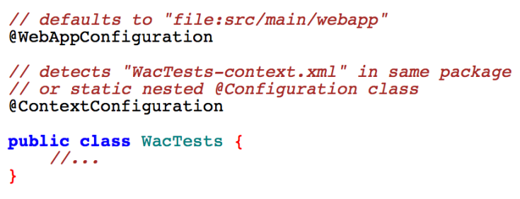
@WAC – Default Values
10

Slide 7
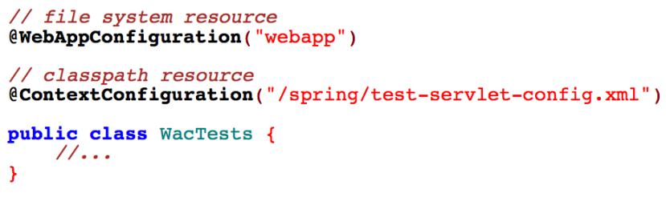
@WAC – Default Resource Types
11

Slide 8
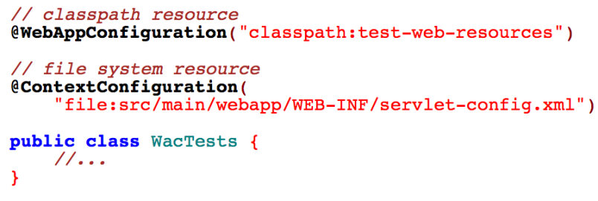
@WAC – Overrides
12

Slide 9
ServletTestExecutionListener
• Sets up default thread-local state via RequestContextHolder before each test method
• Creates:
– MockHttpServletRequest
– MockHttpServletResponse
– ServletWebRequest
• Ensures that the MockHttpServletResponse and ServletWebRequest can be injected into the test instance
• Cleans up thread-local state after each test method
13

Slide 10
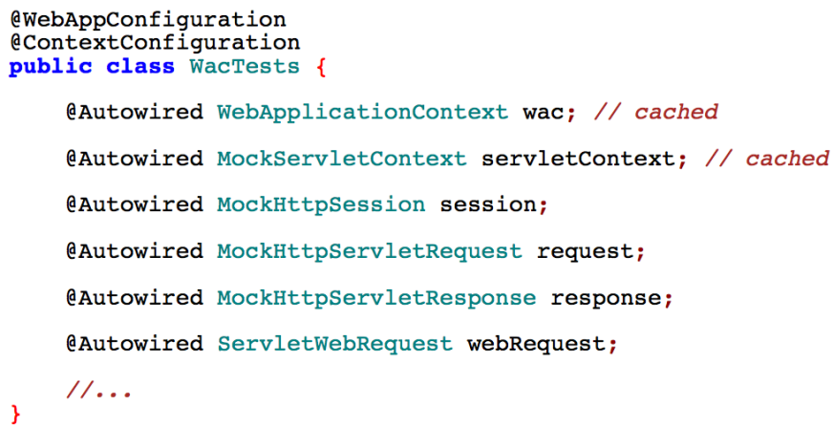
Example: Injecting Mocks
14

Slide 11
Web Scopes – Review
request: lifecycle tied to the current HttpServletRequest
session: lifecycle tied to the current HttpSession
15

Slide 12
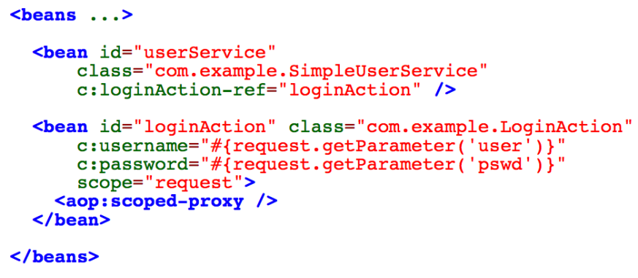
Example: Request-scoped Bean Config
16

Slide 13
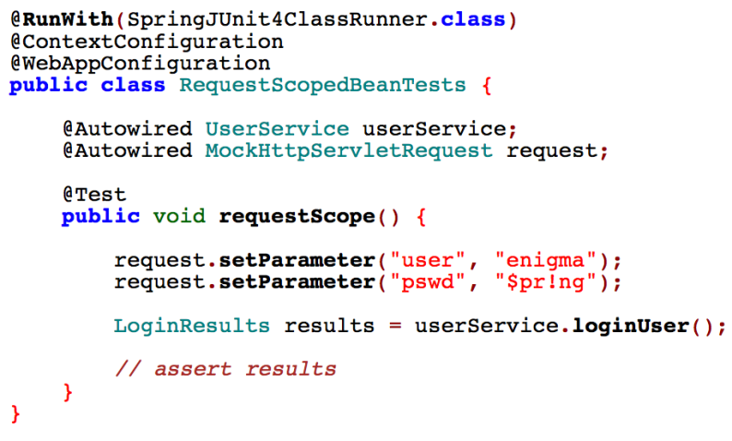
Example: Request-scoped Bean Test
17

Slide 14
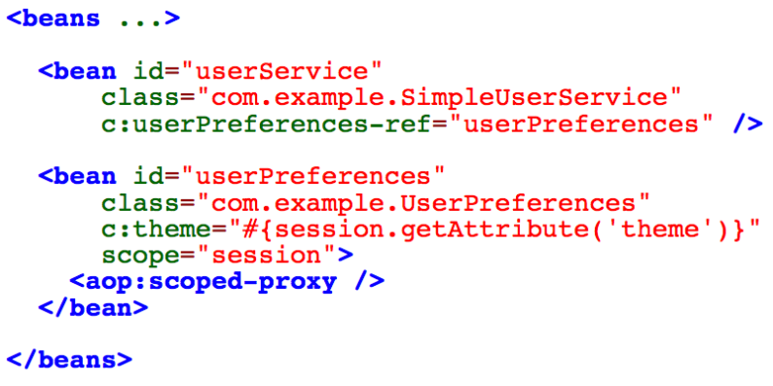
Example: Session-scoped Bean Config
18

Slide 15
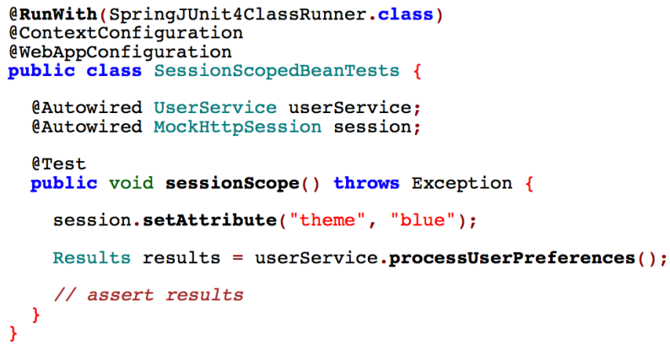
Example: Session-scoped Bean Test
19

Slide 16
ApplicationContextInitalizer
• Introduced in Spring 3.1
• | Used for programmatic initialization of a ConfigurableApplicationContext
• For example:
– to register property sources
– to activate profiles against the Environment
• Configured in web.xml by specifying contextInitializerClasses via
– context-param for the ContextLoaderListener
– init-param for the DispatcherServlet
20

Slide 17
Using Initializers in Tests
• Configured in @ContextConfiguration via the initializers attribute
• Inheritance can be controlled via the inheritInitializers attribute
• An ApplicationContextInitializer may configure the entire context
– XML resource locations or annotated classes are no longer required
• Initializers are now part of the context cache key
• Initializers are ordered based on Spring's Ordered interface or the @Order annotation
21

Slide 18
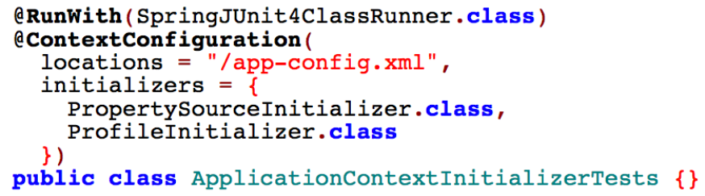
Example: Multiple Initializers
22

Slide 19
Application Context Hierarchies
• Traditionally only flat, non-hierarchical contexts were supported in tests.
• There was no easy way to create contexts with parentT child relationships.
• But… hierarchies are supported in production.
• Wouldn’t it be nice if you could test them, too?!
23

Slide 20
Testing Context Hierarchies in 3.2.2
• New @ContextHierarchy annotation
– Used in conjunction with @ContextConfiguration
• @ContextConfiguration now supports a ‘name’ attribute
– for merging and overriding hierarchy configuration
24

Slide 21
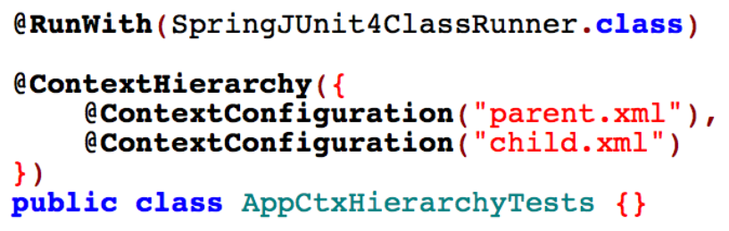
Single Test with Context Hierarchy
25

Slide 22
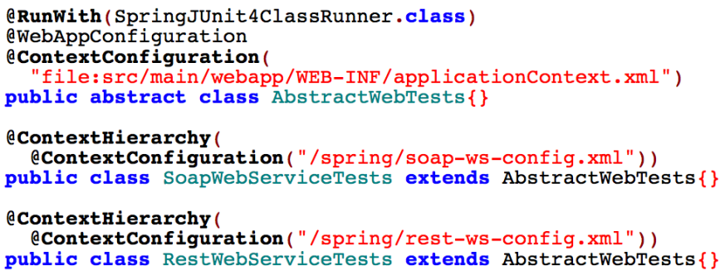
Class and Context Hierarchies
26

Slide 23
Testing Changes in 4.0
Gone:
– JUnit 3.8 support
– @ExpectedException
– @NotTransactional
– SimpleJdbcTestUtils
Updated:
– Servlet API mocks
– Spring MVC Test framework
27

Slide 24
New Testing Features in 4.0
• SocketUtils
– scan for UDP & TCP ports
• ActiveProfilesResolver
– alternative to static profile strings
– set via new resolver attribute in @ActiveProfiles
• Meta-annotation support for tests
28

Slide 25
Meta-annotations in Tests
@ContextConfiguration({
"/app-config.xml", "/test-config.xml"
}) @ActiveProfiles("dev") @Transactional @Retention(RetentionPolicy.RUNTIME) public @interface TransactionalTest { }
@TransactionalTest @RunWith(SpringJUnit4ClassRunner.class) public class UserRepositoryIntegrationTests { /* ... */ }
29

Slide 26
Spring MVC Test Framework
30

Slide 27
What is Spring MVC Test?
• Dedicated support for testing Spring MVC applications
• Fluent API
• Very easy to write
• Includes client and server-side support
• Servlet container not required
31

Slide 28
Details
• Included in spring-test module of Spring Framework 3.2
• Builds on
– TestContext framework for loading Spring MVC configuration
– MockHttpServlet[Request|Response] and other mock types
• Server-side tests involve DispatcherServlet
• Client-side REST testing for code using RestTemplate
32

Slide 29
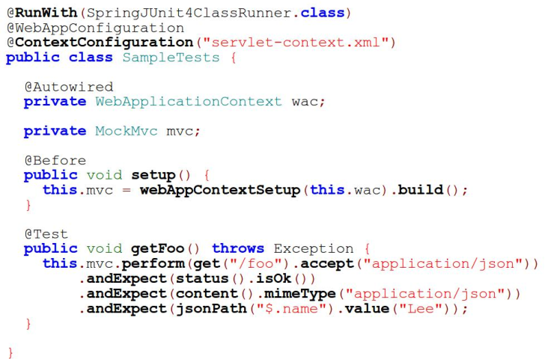
Server-side Example
34

Slide 30
A Note of Fluent API Usage
• Requires static imports
import static MockMvcRequestBuilders.get; import static MockMvcResultMatchers.status;
mockMvc.perform(get(“/foo”)) .andExpect(status().isOk())
• Add as “favorite static members” in Eclipse preferences – Java -> Editor -> Content Assist -> Favorites
35

Slide 31
Server-side Test Recap
• Actual Spring MVC configuration loaded
• MockHttpServletRequest prepared
• Executed via DispatcherServlet
• Assertions applied on the resulting
MockHttpServletResponse
36

Slide 32
Integration or Unit Testing?
• Mock request/response types, no Servlet container
• However …
– DispatcherServlet + actual Spring MVC configuration used
• Hence …
– Not full end-to-end testing; does not replace Selenium
– However provides full confidence in Spring MVC web layer
• In short, integration testing for Spring MVC
– Don't get too caught up in terminology!
37

Slide 33
Strategy for Testing
• Focus on testing the Spring MVC web layer alone
– Inject controllers with mock services or database repositories
• Thoroughly test Spring MVC
– Including code and configuration
• Separate from lower layer integration tests
– e.g., data access tests
38

Slide 34
Declaring a Mocked Dependency
• Since we're loading actual Spring MVC config …
• First declare mock dependency:
<bean class="org.mockito.Mockito" factory-method="mock"> <constructor-arg value="org.example.FooRepository"/>
• Then simply inject the mock instance into the test class
– Via @Autowired or @Inject
– Set up and reset via @Before, @Test, and @After methods
</bean>
39

Slide 35
What can be tested?
• Response status, headers, and content
– Focus on asserting these first...
• Spring MVC and Servlet specific results
– Model, flash, session, request attributes
– Mapped controller method and interceptors
– Resolved exceptions
• Various options for asserting the response body
– JSONPath, XPath, XMLUnit
– Hamcrest matchers
40

Slide 36
What about the view layer?
• All view templating technologies will work
– Freemarker, Velocity, Thymeleaf, JSON, XML, PDF, etc.
• Except for JSPs (no Servlet container!)
– But you can assert which JSP was selected
• No redirecting and forwarding
– But you can assert the redirected or forwarded URL
• Also of interest
– HTML Unit / Selenium Driver integration (experimental)
– https://github.com/SpringSource/spring-test-mvch htmlunit
41

Slide 37
Useful Option for Debugging
Print all details to the console, i.e. System.out
mockMvc.perform("/foo")
.andDo(print())
.andExpect(status().isOk())
42

Slide 38
“Standalone” Setup
• No Spring configuration is loaded
• Test one controller at a time
• Just provide the controller instance
43

Slide 39
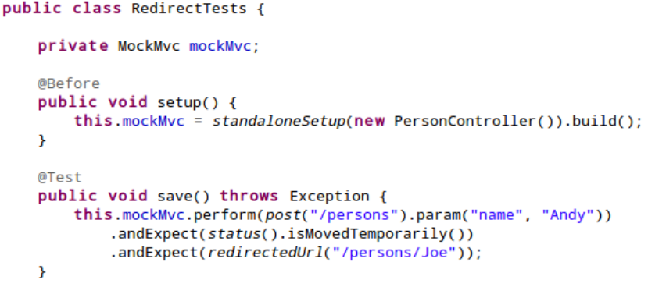
“Standalone” Setup Example
44

Slide 40
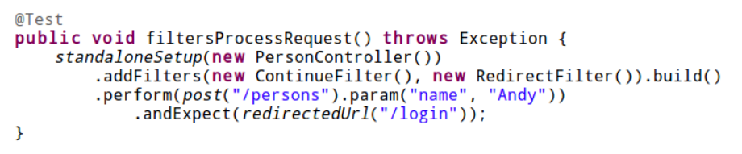
Test with Servlet Filters
45

Slide 41
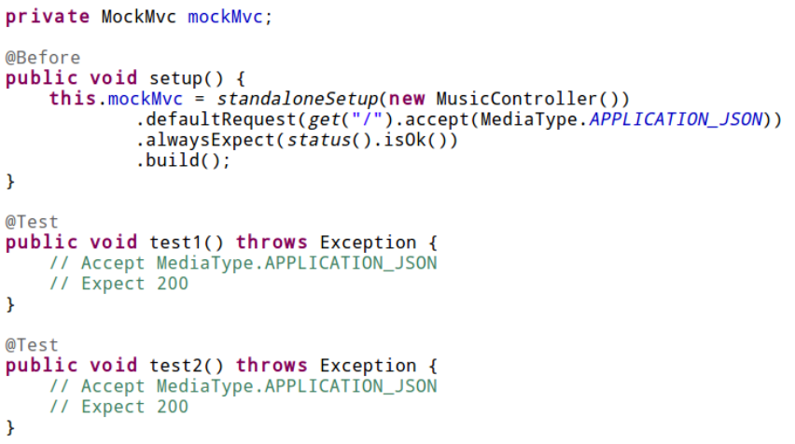
Re-use Request Props & Expectations
46

Slide 42
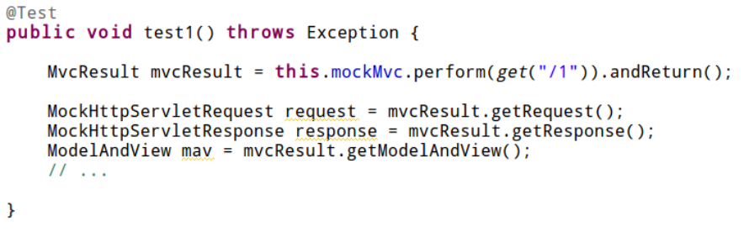
Direct Access to underlying MvcResult
47

Slide 43
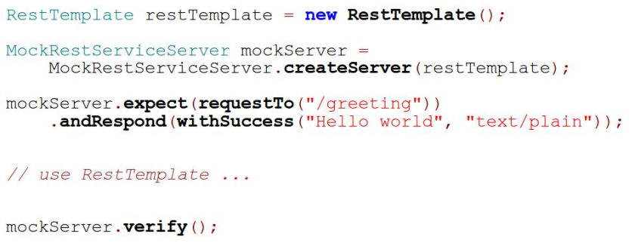
Client-side REST Example
48

Slide 44
Client-side REST Test Recap
• An instance of RestTemplate configured with custom ClientHttpRequestFactory
• Records and asserts expected requests
– Instead of executing them
• Code using RestTemplate can now be invoked
• Use verify() to assert all expectations were executed
49

Slide 45
Acknowledgements
The Spring MVC Test support draws inspiration from a similar test framework in Spring Web Services.
50

